Slide 2
Caring for Caregivers
Lifespan Respite Care
HOST: LIBBY PHAM
GUESTS: MAGGIE GREEN &
KRISTIE CARLISLE

Slide 3
Respite Care Program
Taking care of a loved one can be very rewarding but it can also be challenging. At times, caregivers need a break to recharge and refuel so they can continue to provide care.
The Lifespan Respite Care Program is designed to give caregivers of children and adults with disabilities as well as older adults a break from their caregiving responsibilities.

Slide 4
What is Respite?
Temporary relief for caregivers
Allows caregivers to take a
short break
Without respite, caregivers could
experience burnout

Slide 5
Types of Respite
In Home Respite Care
Out of Home Care
Caregiver chooses someone to come into the home and care for a loved one
Provider must be 18 years or older and not reside in the home
Provider must pass a background check
Memory Care Facility
Adult Day Program
Mental Health Facility
Camp for Children

Slide 6
How Does It Work?
The Respite Care Program
Step One
Step Two
Step Three
Call Care Connection ADRC
Get Screened for Eligibility
Complete Caregiver Well-Being Survey
Complete Respite Application Packet
Identify Provider
Provider Background Check
Get approved
Schedule Provider
Receive Respite

Slide 7
What You Need To Know
Respite Care Program
You are a caregiver caring for a person of any age with a chronic health condition(s) or disability
You are a caregiver NOT utilizing a type of service that relieves caregivers on a temporary or ongoing basis
The care recipient you are caring for is NOT receiving any respite or provider assistance from a local, state or federal agency.
To learn more about eligibility for the Respite Care Program, please call us at 1-855-937-2372 (1-855-YES-ADRC)

Slide 8
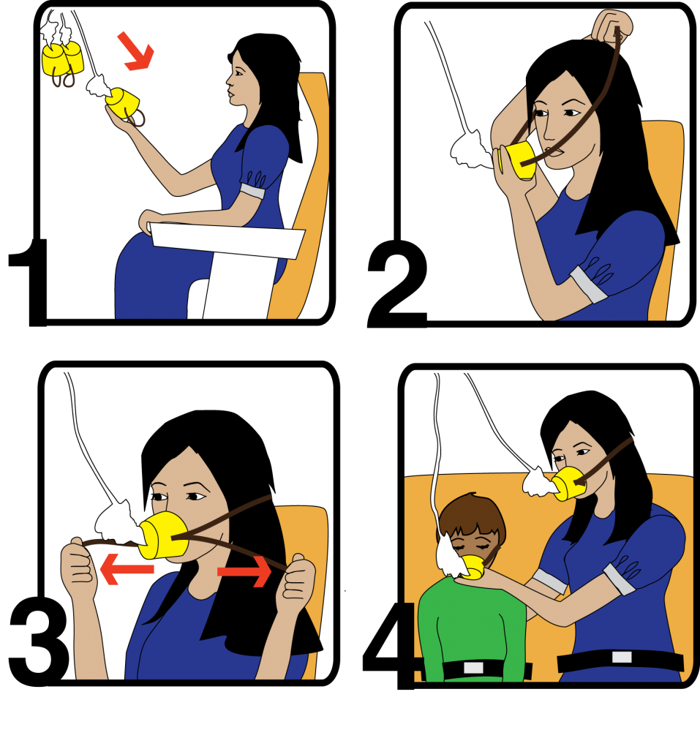
Oxygen Theory
Take Care of You First
Self care is necessary
You cannot be the best caregiver
Possible if you are not well
Your health and well-being
is important

Slide 9
Stay Up To Date On Our Latest Topics
www.careconnection.org
1-855-937-2372
Thank You!

